Slide 1
Surveillance Video Parsing with Single Frame Supervision Si Liu et al.
Zhihao Zhao

Slide 2
i. Problem ii. Model definition iii. Train and test iv. Comparison and reproducibility

Slide 3
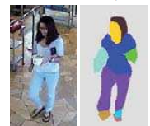
Problem: human parsing
Parse an image to human semantic parts and background in a video.
These parts can be face, hair, upper-clothes, left-arm, right-arm, pants, left-leg, right-leg, left-shoe, right-shoe, bag, dress.

Slide 4
Model Definition
I will explain it from simple to complex.

Slide 5
Naïve Idea on Temporal Fusion
Given a video, there are more than one images for parsing a single human.
A naïve and intuitive idea could be like this:
1. Parse, say, 3 images at different time using FCN, mask-RCNN or others. (DeepLab used here)
2. adjust parsing result according to optical flow to the same time.
(person at different frames may have different poesture)
3. Fuse them(with several 1 ×1 filters). (1×1 filters can be seen as linear combination)

Slide 6
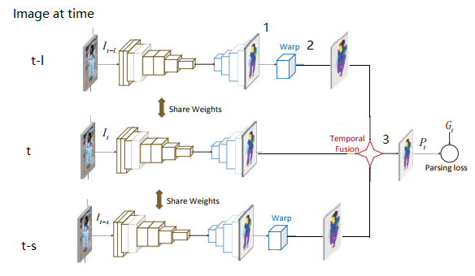
Naïve Idea on Temporal Fusion
Parse 3 images
Adjust parsing result
according to optical flow to
the same time
Fuse them with several
1 ×1 filters.

Slide 7
Optical Flow
Note that even during training process, the optical flow between two images are not labeled.
To get the optical flow, it can be calculated in an another process or integrated to existing model. The latter is used. I think there are three reasons:
i) Simpler pipeline, making the model easier to inference. But harder to train(see later).
ii) Because parsing part is used to label pixels and
optical flow part is used is used to calculate pixels’ offset,
the two parts should be able to share at least weights in some layers(if the two part has the same structure, indeed there exists such an algorithm FlowNet, see later).
iii) Making the method elegant.
My understanding about weights share in (ii). It can be thought as a multi-task problem on the same object. So some low-level features can be shared.

Slide 8
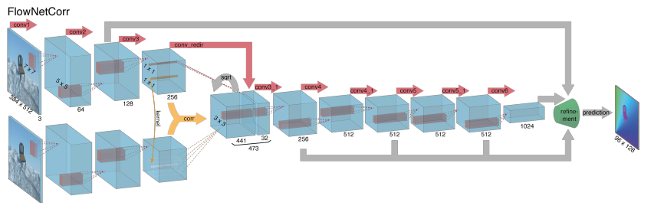
FlowNet: CNN on Optical Flow -- architecture
2015, FlowNet: Learning Optical Flow with Convolutional Networks

Slide 9
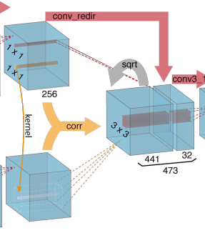
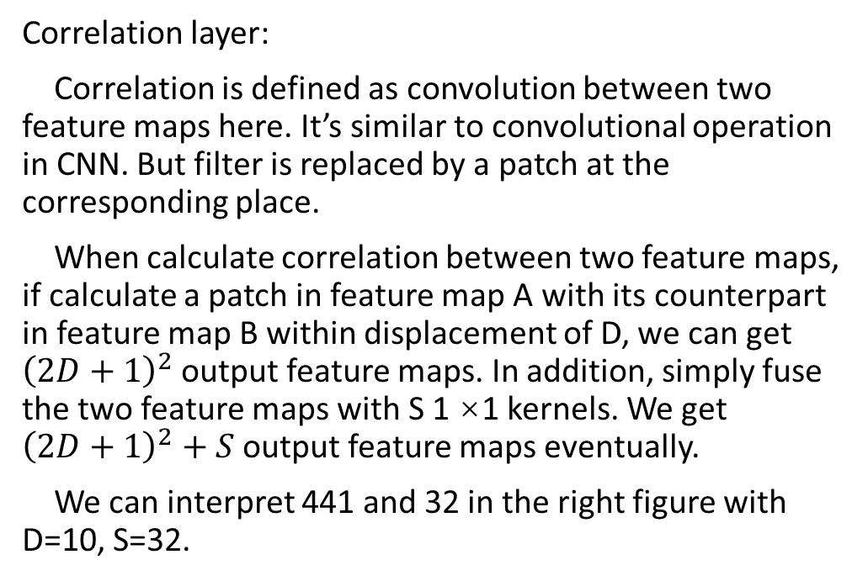
FlowNet: CNN on Optical Flow -- key concept
Correlation layer:
Correlation is defined as convolution between two feature maps here. It’s similar to convolutional operation in CNN. But filter is replaced by a patch at the corresponding place.
When calculate correlation between two feature maps, if calculate a patch in feature map A with its counterpart in feature map B within displacement of D, we can get ${\left(2D+1\right)}^{2}$output feature maps. In addition, simply fuse the two feature maps with S 1 ×1 kernels. We get ${\left(2D+1\right)}^{2}+S$output feature maps eventually.
We can interpret 441 and 32 in the right figure with D=10, S=32.
From “FlowNet: Learning Optical Flow with Convolutional Networks”

Slide 10
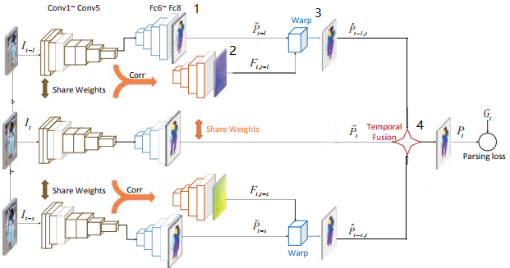
Integrate optical flow and temporal fusion
Parse 3 images
Integrate optical flow net
Adjust parsing result
according to optical flow to
the same time
4. Fuse them with several
1 ×1 filters.

Slide 11
Question on integrated model
Question:
Optical flow is estimated. It absolutely contains errors. Some error may be too large to ignore.
A simple solution:
Remove/reduce optical flow points with large error. And again, integrate this process to existing model.

Slide 12


Estimate optical flow error -- confidence
It’s estimated respect to L-1 norm of reconstruction error.
First, reconstruct every pixel in estimate image using original point and optical flow.
Then calculate the L1 distance on original pixel and estimate pixel.
The confidence is calculated as
where σ is the mean value of
Having confidence C on the whole generated parsing image P, the reduction is defined as P*C, where * denotes dot product. (I think dot product doesn’t have intuitive sense, P elementwise multiply round(C) should be better)

Slide 13
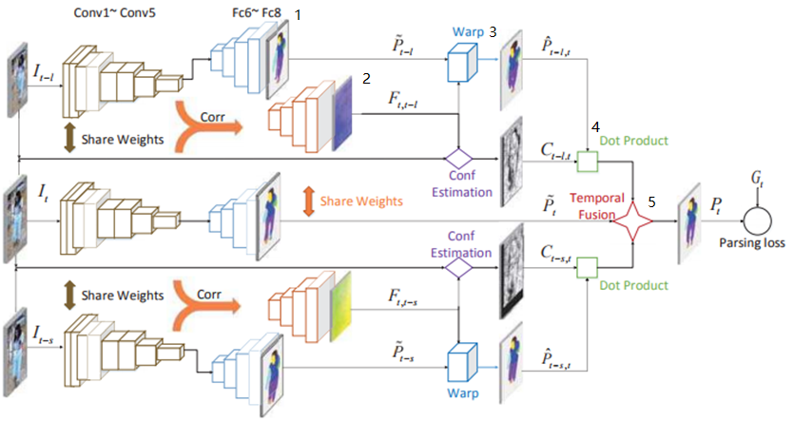
Integrate reduction and existing model
Parse 3 images
Integrate optical flow net
Adjust parsing result according to optical flow to the same time
Reduce influence of inaccurate optical flow
Fuse them with several 1 ×1 filters.

Slide 14
From scratch to end – naïve idea

Slide 15
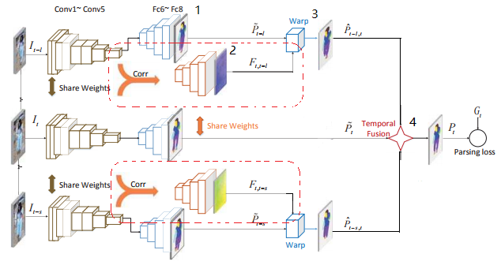
From scratch to end – integrate optical flow

Slide 16
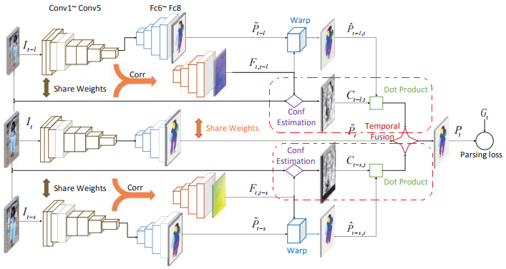
From scratch to end – reduce inaccurate point

Slide 17
Train, Test

Slide 18
Train
The author tried to train all together, but they failed. Red words is just my own understanding.
1. Train whole model but parsing and optical flow part do not share weights. Parsing and optical flow part is initialized by VGG. Temporal fusion part is initialized by Gaussian N(0, 1).
This may be enough. Weights share between parsing and optical flow may decrease the performance. Weights share can improve speed.
2. Fix the conv layers of optical flow part by parsing part, only fine-tune the layers unique to optical flow. So the parsing and optical flow parts share conv layers.
This is intuitive if we think about the concept of “fine-tune”. When borrow weights on low layers, the weights on high layers should be trained on specific problem’s dataset.
3. Fix the conv layers of parsing part, only fine-tune the layers unique to parsing and temporal fusion sub-networks.
Like 2, weights of optical flow part has been changed. So the rest part should be fine-tuned.

Slide 19
Comparison and reproducibility

Slide 20
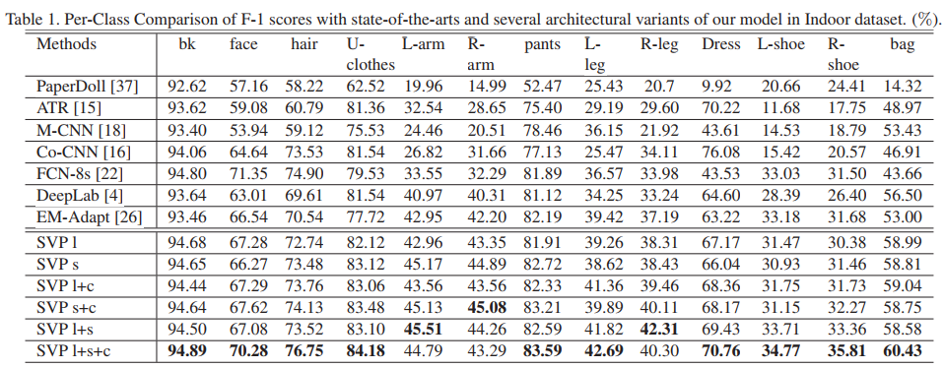
Comparison with state-of-the-art

Slide 21
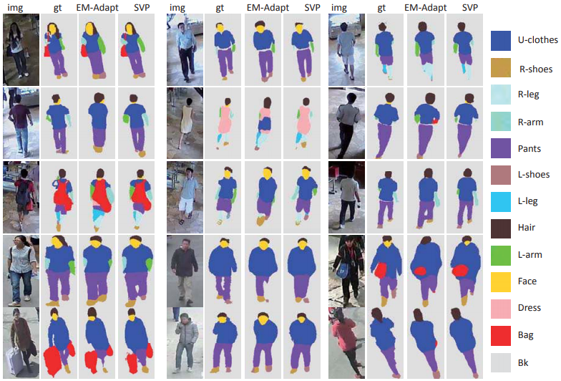
Comparison with state-of-the-art

Slide 22
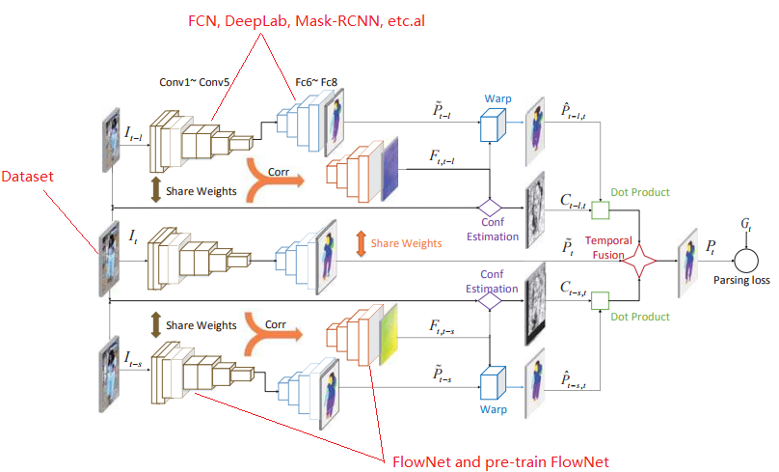
Reproducibility

Slide 23
Reproducibility
Parsing part: available on github.
Flownet: available on github.
Dataset: can’t find the dataset the author used. It will be released later.

Slide 24
Thinking
If we have a quick way to deal with the pixel correlation among images, we may use all frames in a video instead of just 3 frames.
Since this paper just use linear combination result at 3 frames, combine result at more and more frames should gain better result.

